Slide 1
Remove pricing where ever given like Rs. 10 in this case based analysis
BillionTests
Strip-based analysis is one of the simplest, fastest, and most cost-effective ways to get a preliminary diagnosis of critical health parameters—for ₹10 per test. Yet, despite its potential for scale, current approaches are riddled with challenges that prevent widespread adoption and reliable use, whether for humans, livestock, or pets.
Challenges with Current Approaches:
1: Manual Reading
Error-prone (depends on lighting, color perception, human judgment)
Slow (requires reading strips carefully at precise intervals)
Requires trained personnel (not scalable for home/field use)
Not scalable for mass screening programs
2: Imported Machines
Expensive (₹1-2 lakh per analyzer)
Dominated by foreign brands (Siemens, Roche, Abbott, Menarini)
Usually single-purpose (proprietary strip dependency)
Lab-bound (require electricity, stable environment)
3: Lab-Based Testing
Infrastructure-dependent
24-48 hour delays for results
Centralized data (no real-time health visibility)
High costs for patients
Impact:
Patients, farmers, and pet owners end up paying more, waiting longer, and health systems lose the chance for real-time, scalable diagnostics.

Slide 2
Future Expansion
BillionTests
BillionTests is not limited to urinalysis — the same AI + IoT + Blockchain platform can power a universal diagnostic ecosystem:
Blood Tests → Hemoglobin, cholesterol, malaria, and rapid test kits.
Glucose Monitoring → Affordable, at-home diabetes management.
Pregnancy & Fertility Tests → hCG, ovulation strips.
Infectious Disease Strips → Malaria, dengue, COVID-19 antigen/antibody kits.
Veterinary Diagnostics → Affordable tests for livestock and pets.
Other Colorimetric Strips → Extensible to 30+ strip types across human and animal health.Adaptable to over 30 test strip variants across human health diagnostics licensed under CDCO.
Vision: From a urine-based gateway test to a comprehensive, low-cost diagnostic platform serving billions.

Slide 3
Innovation and novelty
BillionTests
1. Radically Affordable
₹1,999 device vs ₹1-2 lakh imports (99% cost reduction) Mention OPEX model against Capex expenditure of 1-2 Lakh
₹10 per scan vs ₹50-200 lab tests . 10X lower cost than Affordable VS 100-300 by any diagnostic Lab
Truly universal - works with ALL govt-approved strips—no vendor lock-in
Leverages mature supply chains instead of reinventing hardware
2. AI-Powered Accuracy
98% accuracy validated on 200+ samples
Trained on 100,000+ diverse images
Eliminates human reading errors and subjective interpretation
Continuous learning from real-world data
3. Zero-Friction Testing
Single-click smartphone app (Android/iOS)
BT Cards handle lighting/environmental variations automatically
No medical training required
Works anywhere—home, clinic, or remote village
Lean-by-design architecture – Uses existing strips, smartphones, and mature supply chains instead of reinventing hardware, enabling massive cost reduction and rapid scale.
The Bottom Line: Lab-grade diagnostics at 1% of the cost, accessible to anyone with a smartphone
3

Slide 4
Remove pricing where ever given like Rs. 10 in this case based analysis
ionTests
ntroduction
BillionTests
Key Differentiators:
Works with 30+ types of diagnostic strips (human, cattle, pet)
98% accuracy through AI-powered image analysis
₹10 per scan (mobile app) or ₹1,999 portable device Opex based at place of Capex Like ₹40k–₹2L imported analyzers)
Completely Made in India
Portable, offline-capable, electricity-free operation, field ready
Blockchain-secured, tamper-proof results for data trust
Compatible with all govt.- approved strips
Remove 30+ type of diagnostic strips. Mention following
Works with all different type of standard urine test strips licensed under CDSCO (Central Drugs Standard Control Organisation)
ionTests: Introduction
The platform delivers lab-grade accuracy at field-level affordability, addressing critical gaps in India's preventive healthcare infrastructure.
Why Urine-Based Screening Is Powerful in India
  Low cost, non-invasive
  No lab dependency
  Results in 1–2 minutes
  Ideal for rural areas, elderly care, mass screening
No education needed – single click operation
4

Slide 5
SOCIAL & PUBLIC HEALTH IMPACT
BillionTests
Key Benefits
Early Disease Detection:
Identifies at-risk individuals before symptoms develop
Enables timely intervention and treatment
Reduces progression to severe complications
Reduced Healthcare System Load:
Decreases tertiary hospital admissions
Enables preventive care at primary level
Optimizes resource allocation
Community Health Data:
Real-time population health monitoring
Data-driven policy decisions
Epidemic/outbreak early warning
Health Equity:
Brings diagnostics to underserved populations
Bridges urban-rural healthcare gap
Empowers community health workers
2. Alignment with National Goals
SDG 3: Good Health and Well-being
Ayushman Bharat: Preventive healthcare mission
National Health Mission: Universal health coverage
Digital India: Healthcare digitization
Skill India: Empowers workers with technology
3. Global Impact Potential
According to Lancet Commission:
47% of global population lacks access to early diagnostics
BillionTests addresses this through:
  Ultra-low cost (<$2 per test) (Remove cost)
  No infrastructure requirement
  Simple operation (single click)
  Scalable deployment model

Slide 7
Trade mark id not for BT Card it is for following so us them and mention in website
    BILLIONTESTS.AI™
    BTCARDX™

Slide 9
At place of only Kidney disease
mention urinary tract infections (UTIs) , kidney disease, Kidney stones, diabetes, dehydration and liver or bile duct problems.
BillionTests
Parameter | Indicates Possible
Protein | Kidney disease, dehydration, intense exercise, kidney stones
Leukocytes (WBC) | Infection, UTI, kidney stones
Ketones | Low-carb diet, diabetes
Glucose | Diabetes (if >180 mg/dL)
Nitrites | Bacterial infection (E. coli, Gonorrhea)
Blood | UTI, intense exercise, kidney stones
Urobilinogen | Liver disease, cirrhosis, hepatitis, liver damage
pH (6.7–7.5) | Uric acid stones, excess protein intake
Specific Gravity | Dehydration, urine concentration issues
Bilirubin | Early liver disease, blocked bile duct

Slide 12
Sethi ji
Alok
Abhishek
sahil

Slide 13
1st row Founder and co-founder 4Nos
  MPS
  ALOK
  ABHISHek
  Sahil
2nd row Development team 4Nos
    Pranav
    Pramod
    Ritu
    Mohni
3rd row of Mentors and employees 8Nos
1 & 2 row in one page
3rd row in next page

Slide 14
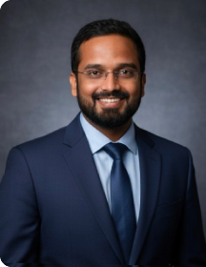
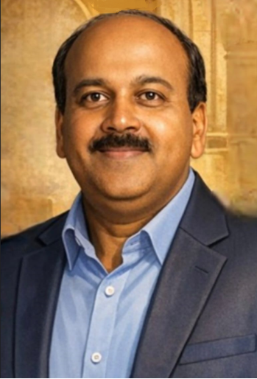


THE TEAM
Vision: Transform existing industrial camera infrastructure into intelligent inspection and monitoring systems to drive operational efficiency and cost saving.
Pranav Asthana
Pramod Prasad
Ritu Mishra
Co-Inventor & Platform Head
RevOps Leader
Co-Inventor & Head of Innovation
Cofounded visotonics, Checko,
Upjao. $25M exit
20+ research papers,
10+ patents
Ex-Intel, IIT Kanpur
Cofounded visotonics, Upjao.
8 years in building deep tech products.
Ex-researcher at NCFlexe, IIT Kanpur.
Cofounded visotonics,
30+ years of technology business leadership | Built $150M+ business portfolios | Scaling AI-led enterprise innovation.
Ex-Cisco | Motorola | Ericsson | IIFT
Mohini Behera
Co-Inventor & Chief Scientist
Cofounded visotonics, Upjao. Developed 10+ AI products for large enterprises.
IIT Jodhpur, NIT Rourkela

Slide 15



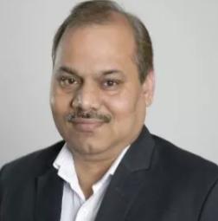
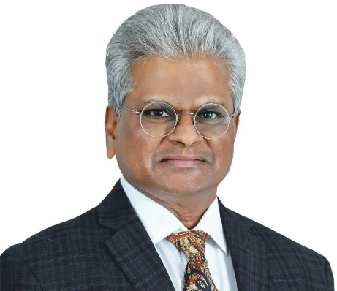
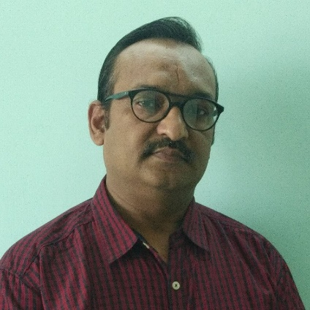


Team: Mentors and employees
BillionTests
Prof. Amitabha Bandyopadhyay
Medical Advisor
BSBE, IIT Kanpur
Ex-Harvard Medical School
Dr. Shikha Dhawan
Medical Advisor
Founder, Biozazen
Ph.D. (Delhi University)
Dr. RAVI VEDURURU
Subject Matter Expert
PhD Exec. MBA , Clinical Dx & Medical device Consultant
Dr. Sudheer Kumar
Technical Advisor
COO (NCFlexe, IIT Kanpur)
Ph.D. (NPL)
Dr. Sudhindra Tatti
Business Advisor
CEO of Prompt Innovations
Ph.D. (University of Texas, Austin)
Neeraj Garg
Strategic Advisor
Partner, SBM Advisors
Ex-CTO AMUL, NDDB
Prof. Sandeep Kumar
Technical Advisor
EE, IIT Delhi
Ph.D. (IIT Kanpur)
Prof. Vinod Kurmi
Technical Advisor
EE, IISER
Ph.D. (IIT Kanpur)

